Slide 1
JavaScript
Intro to Client-Side JavaScript

Slide 2
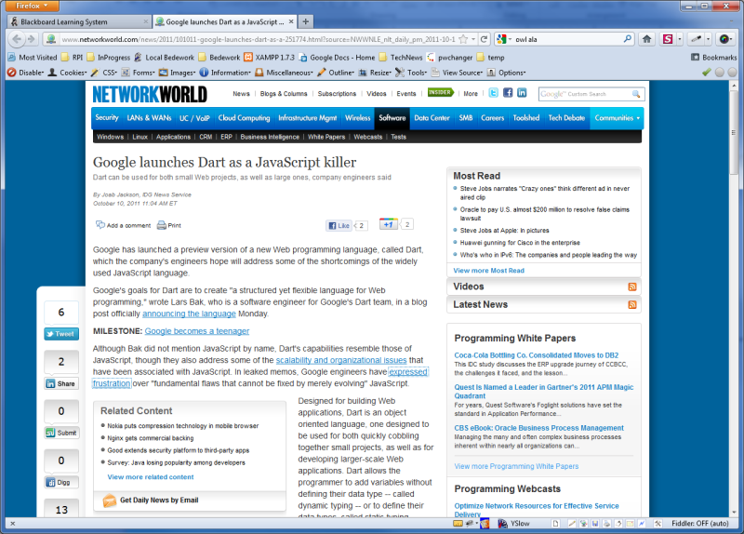

Slide 3
"Increasingly, consumers have two ways to access the Internet and Web-based information services. Many still do it the traditional manner: through a Web browser. But a growing number of consumers are turning to smartphones as their primary means of accessing those services, and their window to the Web is not the mobile browser, but purpose-built smartphone apps.
"The problem? Smartphone app platforms such as iOS tend to be closed, vertically integrated, and proprietary -- precisely the opposite of the open, standards-based Web. If that's a topic you care about, you should be paying very close attention to Dart, River Trail, and the ongoing evolution of JavaScript."
McAllister, Neil. (2011) The great JavaScript debate: Improve it or kill it? InfoWorld. Retrieved October 11, 2011 from http://www.infoworld.com/d/application-development/the-great-javascript-debate-improve-it-or-kill-it-173674?page=0,1

Slide 4
What is JavaScript?
Rich programming language
ECMAScript - widely adopted standard
Standard maintained by ECMA International (at one time European Computer Manufacturers Association)
Primarily ECMA-262, edition 3 (1999) …Edition 5 recently approved (Dec 2009)
Commonly used to interact with browsers and build rich web user interfaces / applications
Think Google, Facebook, Yahoo, you name it...
Interpreted (typically, though it can be compiled)
Object-oriented capabilities

Slide 5
Using Javascript
Javascript can be embedded in the <head> or <body> section of an HTML document: <script type="text/javascript"> document.write(firstName); </script>
You can link to an external file in <head>: <script src="my.js" type="text/javascript"> </script> (The closing script tag is required... both by the W3C and by most browsers which won’t work correctly without it.)

Slide 6
Some Basics
Data types:
Primitives: numbers, strings, and Boolean values
Objects: arrays, dates, and regular expressions
Examples: var currentCount = 3; // an integer var firstName = "Mary"; // a string var isAvailable = true; // a boolean var now = new Date(); // a date object /* The above is how we declare variables. See that multi-line comments can be written like this. */

Slide 7
More Basics
Javascript is case-sensitive
Javascript statements terminate at the ends of lines and at semi-colons
use the semi-colons, and don’t get caught off guard by the ends of lines, e.g. var myPhrase = "This longish string won’t work if I break it onto two lines like this"; note: var myPhrase = "This longish string will work if I break\ it onto two lines with a backslash";

Slide 8
Strings
Strings are the data type for representing text.
Strings can be concatenated using the addition operator: var fullName = firstName + " " + lastName;

Slide 9
Before we begin...
We should examine
the Javascript console,
the notifications from the Web Developer Toolbar,
and Firebug
These tools are essential for getting feedback

Slide 10
Let’s Get Started
Open Lab 5 from the LMS and download the six starting templates (by right-clicking on the links).
In the js-inclass.js file, you'll find three variables:
var firstName = "Hector"; var age = 19; var insuranceCutOffAge = 26;
In your js-inclass.html file, use a document.write() to write the phrase "Hector is 19" (replacing name and age with the actual values stored in the variables): document.write(firstName + " is " + age);

Slide 11
Control Statements
Control statements provide a means of controlling code execution using loops and conditional tests.
if – allows us to test a condition and execute code if the condition is true if (expression) { statement; }
Try this example: if (age < insuranceCutOffAge) { document.write("You can be insured"); }
Now change this statement to use the firstName variable. Then change the value of the age variable to make this statement false.

Slide 12
if...else
if (condition) { do something; } else { do something different; }
Modify the code you just wrote to include an else statement.
Change the age variable and watch the conditional statement execute differently.

Slide 13
Boolean expressions
Comparing values
var x=3; var y=5; var available = true;
x == y // false: the equality operator is == x < y // true x + 2 == y // true !available // false: the logical NOT operator is !

Slide 14
Events
A browser fires events when a user interacts with it
When clicking an item (an onclick event)
When the cursor enters an input field (an onfocus event)
When hovering over an item (an onmouseover event)
When a document is fully loaded (an onload event)
When a form field is changed (an onchange event)
And so on ...
Try this: <button type="button" onclick="alert(firstName);"> Who's there? </button>

Slide 15
Functions
Functions are blocks of code that can be called programmatically and executed repeatedly
They can accept parameters and can return values
There are many predefined functions, for example: alert("hi!"), and you can write your own: in your js file: function cube(x) { return x * x * x; } in your html file: <a href="javascript:alert(cube(5));"> You can put JavaScript in an anchor tag too. </a>

Slide 16
Objects
A collection of named values (called properties)
When a function is a property of an object, we call it a method
We access an object’s properties and methods using "dot notation": document.write("write() is a method of the document object"); var fnLength = firstName.length;

Slide 17
Browser Objects
The Window object
The browser object that serves as the access point for all other objects
This object represent the web browser window itself (or a frame within that window)
The Document object
A property of the window object that represents the HTML document within it

Slide 18
Browser Object Hierarchy
self, window, parent, top
window
navigator
frames[]
forms[ ]
elements[ ]
location
anchors[ ]
options[ ]
history
links[ ]
for <select> element
document
images[ ]
screen
applets[ ]

Slide 19
What is the DOM?
The Document Object Model
It is the document subtree of the Window object
Level 0 of the DOM are those objects in the previous slide colored in orange
These are supported in all major browsers – and have become a de-facto standard
The W3C continues to work on DOM standardization:
"The Document Object Model is a platform - and language -neutral interface that will allow programs and scripts to dynamically access and update the content, structure and style of documents."
Ok – let’s look at the W3Schools DOM reference: http://www.w3schools.com/jsref/

Slide 20
Interacting with the Browser
You can call on the Window object’s property and methods using dot notation. The full path to some of the methods we’ve been using are actually: window.document.write("full path"); window.alert("I'm a method of window.");
(But we often use shorthand when referencing the window object’s properties and methods.)
Assign the following JavaScript to a button: window.location = "http://www.rpi.edu";

Slide 21
Interacting with the DOM
One of the most common activities in client-side scripting is manipulating pieces of the DOM
Making things appear and disappear (using css)
Inserting and removing elements (e.g. a news feed)
Manipulating form fields and values
Animating images
Changing element values
Assign a button to change the title of your document: window.document.title = "New Title";

Slide 22
Grabbing Elements by ID
getElementById(id) is a very useful feature for getting hold of a particular HTML element:
// get hold of our <div id="output">…</div> var element = document.getElementById("output"); // now we have it, let’s modify its innerHTML property: element.innerHTML = "Some new text.";
Ok - write a function that contains the code above, and then create a button to run it.

Slide 23
HTML Forms 1 of 3
Forms are used for capturing user input
They are often used with the HTTP POST method
Forms have a limited number of elements:
Text input fields
Text areas
Select (pull-down) boxes
Checkboxes
Radio buttons
Hidden fields
Submit buttons...

Slide 24
HTML Forms 2 of 3
<form action="someserverpage.php" method="post">
<label for="fname">First name:</label> <input type="text" name="fname" id="fname" />
<label for="lname">Last name:</label>
<input type="text" name="lname" id="lname"/>
<input type="submit" value="Submit" />
</form>

Slide 25
HTML Forms 3 of 3
Open lab5.html and look at the <form> in the HTML
Note that you can reference this form's elements in one of two ways*:
by path: document.addForm.firstName; document.forms[0].elements[0] will also work…
by ID: document.getElementById(firstName);
To get at the field’s value, you need to ask for that property: document.addForm.firstName.value;
Create a button below the Contact Information box that displays the value of the first name field when clicked.

Slide 26
Passing the Current Object
The JavaScript keyword "this" refers to the current object
It is used as a shorthand to access the object that is currently being acted on, e.g. clicked Add this onchange event to one of the input fields: <input type="text" onchange="alert(this.value)"/> What happens?

Slide 27
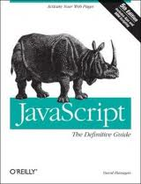
Resources
JavaScript and HTML DOM (W3Schools) http://www.w3schools.com/jsref/
JavaScript : The Definitive Guide David Flanagan, O'Reilly & Associates
6th edition is latest (April 2011) Covers ECMAScript 5 and HTML 5

Slide 28
Lab 5: JavaScript
Create an HTML form with user feedback and validation
Guidelines - see the lab in the LMS for more – below is a partial list :
Use the three template files as your starting point: lab5.html, lab5.css, and lab5.js
You must validate the form fields: no text field can be empty
If a user clicks in the textarea, make the text "Please enter your comments" vanish (but only that text – not the user’s text)
If the form is successfully submitted, show a success message (using an alert() box) to the user
You must highlight each text input field with a background color when it gets the focus (when the cursor is in the field) - use CSS
You will be graded on validity (3 pts), indentation (2 pts), completeness (3pts), and quality (2 pts)
This lab is due by the evening of Monday, October 15, 2012.

